Slide 1
Fraud Detection
Presented By: Subodh Kumar

Slide 2
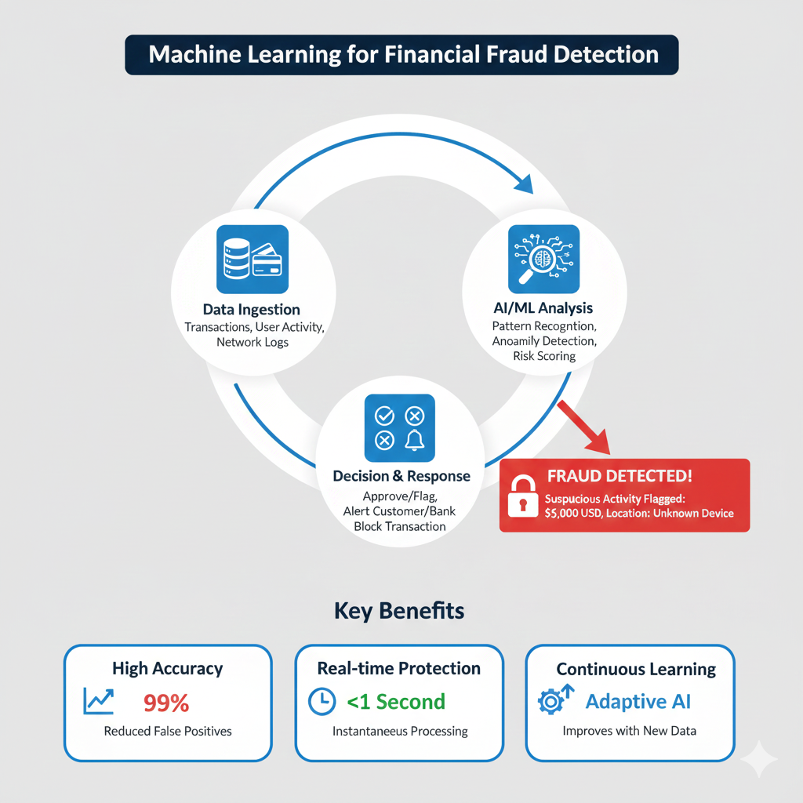
INTRODUCTION
Financial fraud is a growing challenge in digital banking and online transactions. With millions of transactions happening every day, identifying fraudulent activities manually becomes nearly impossible. Machine learning helps detect these fraudulent patterns automatically, enabling companies to reduce financial losses and protect customers.

Slide 3
Introduction
Dataset Overview
Exploratory Data Analysis
Feature Engineering
Handling Class Imbalance
Model Building
Model Evaluation
Conclusion
Final Results
Explainability (SHAP)

Slide 4

Problem Statement & Goal
Problem Statement:-
To identify fraudulent financial transactions using machine learning by analyzing customer transaction patterns and predicting whether a given transaction is fraudulent or not.
Goal:-
To build a machine learning model that can accurately detect fraudulent transactions.

Slide 5
Data Collection
Step
Originiater Balances
Recipient Balances
Target : is Fraud
(1)Fraud, (0)Not Fraud
Type
Amount
The dataset used in this study contains financial transaction records provided for fraud detection research. It includes details such as transaction type, amount, account balances, and a label indicating whether the transaction is fraudulent.

Slide 6

Exploratory Data Analysis
In the EDA phase, I analysed user transaction patterns and compared fraudulent vs. non-fraudulent transactions. The analysis revealed key insights in transaction types, amount behaviour, balance differences, and time-series fraud trends. Correlation analysis and advanced visualizations helped identify strong fraud indicators such as zero-balance flags and abnormal balance drops.

Slide 7
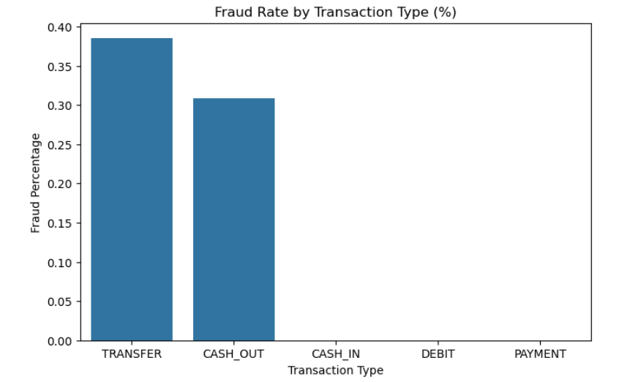
Fraud Rate by Transaction Type
The bar chart shows the fraud rate for each transaction type. We observe that fraudulent activities are concentrated only in two transaction types: TRANSFER and CASH_OUT. TRANSFER has the highest fraud rate (~38%), followed by CASH_OUT (~31%). Other transaction types such as CASH_IN, DEBIT, and PAYMENT show almost no fraud cases. This indicates that fraudsters prefer transaction flows that allow easy movement or withdrawal of funds.

Slide 8
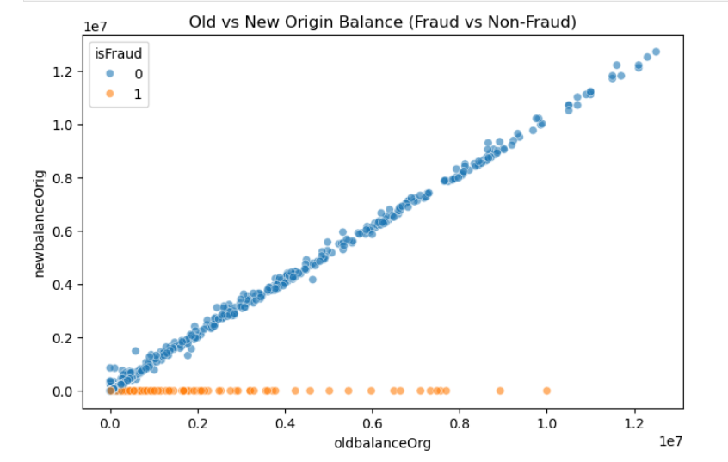
Balance Difference as a Strong Fraud Indicator:
The difference between old and new origin balances (org_diff) is much higher in fraud cases. This engineered feature highlights a clear signal: Fraudsters commonly withdraw or transfer entire available balance, making this one of the strongest predictors in the model.

Slide 9
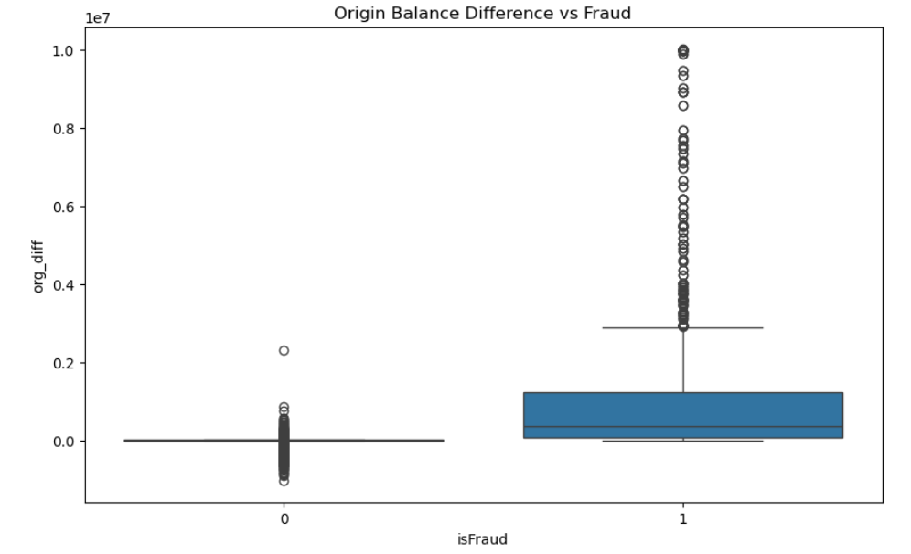
Origin Account Balance Pattern (Before vs After Transaction):
Normal (non-fraud) transactions show a clean linear relationship between old and new balances. Fraud transactions break this pattern — balances often drop to zero immediately, suggesting accounts are emptied intentionally.

Slide 10
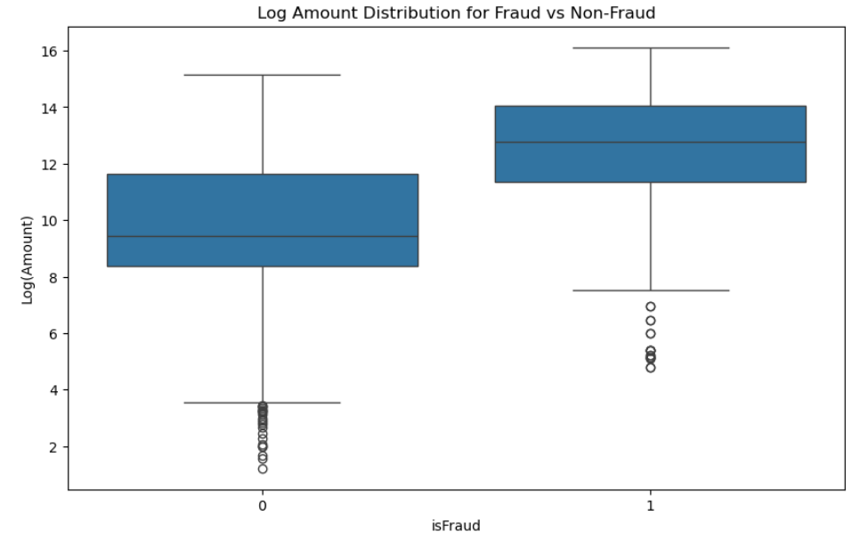
Transaction Amount Behavior (Log Scale):
Fraud transactions typically involve higher monetary values compared to normal transactions. The median log amount is significantly higher for fraud, suggesting fraudsters prefer high-value transfers to maximize profit.

Slide 11
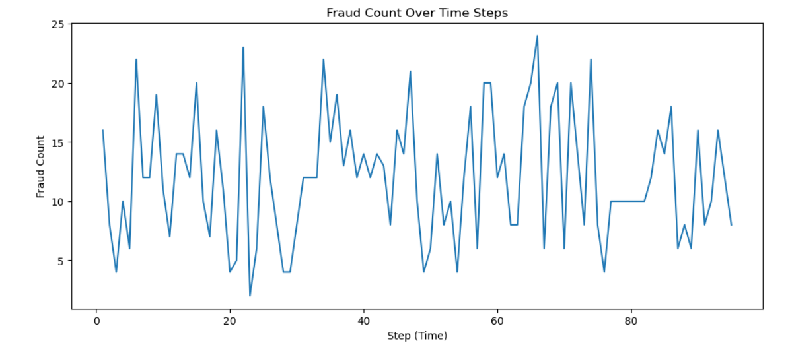
Fraud Occurrence Trend Across Time Steps:-
This chart shows how the number of fraudulent transactions fluctuates over different time steps. Instead of being evenly distributed, fraud occurrences appear in sudden spikes, indicating burst patterns or coordinated fraud attempts. The variability suggests that fraud does not follow a fixed frequency or time interval, making real-time detection systems essential to handle unpredictable fraud behavior.

Slide 12
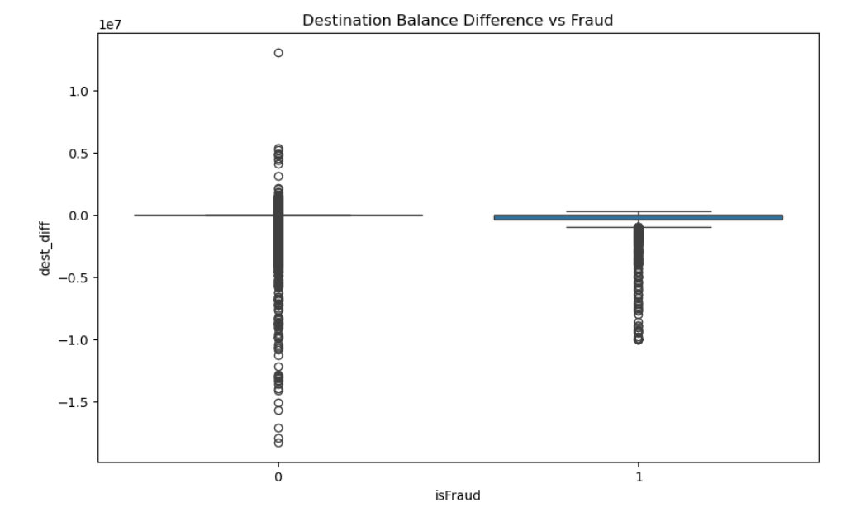
Destination Account Balance Behavior in Fraud vs Non-Fraud Transactions:
This chart compares the change in the destination account’s balance (dest_diff) for fraudulent and non-fraudulent transactions. Non-fraud transactions show a wide and inconsistent range of balance changes, indicating typical customer activity such as receiving money or transferring partial amounts. In contrast, fraudulent transactions have relatively small and stable destination balance differences because fraudsters often transfer money into accounts that remain nearly empty or are created solely for fraudulent activity. This shows that abnormal or near-zero destination balance movement is a key fraud indicator.

Slide 13
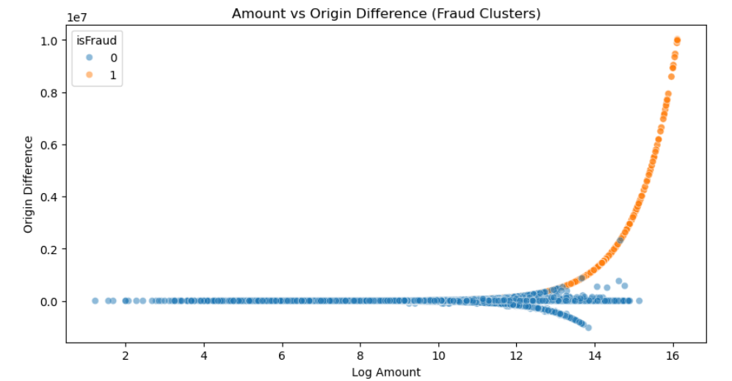
Fraud Clusters Based on Transaction Amount and Origin Balance Difference:
This scatter plot reveals clear separation between fraudulent and non-fraudulent transactions when comparing log-transformed transaction amounts with the difference in origin account balance. Fraudulent transactions (orange) form a distinct upward curve, showing extremely high balance differences associated with large transaction amounts. In contrast, non-fraud transactions (blue) remain close to zero in balance difference, regardless of the amount. This indicates that fraud is strongly characterized by sudden, large withdrawals from origin accounts combined with high-value transfers.

Slide 14
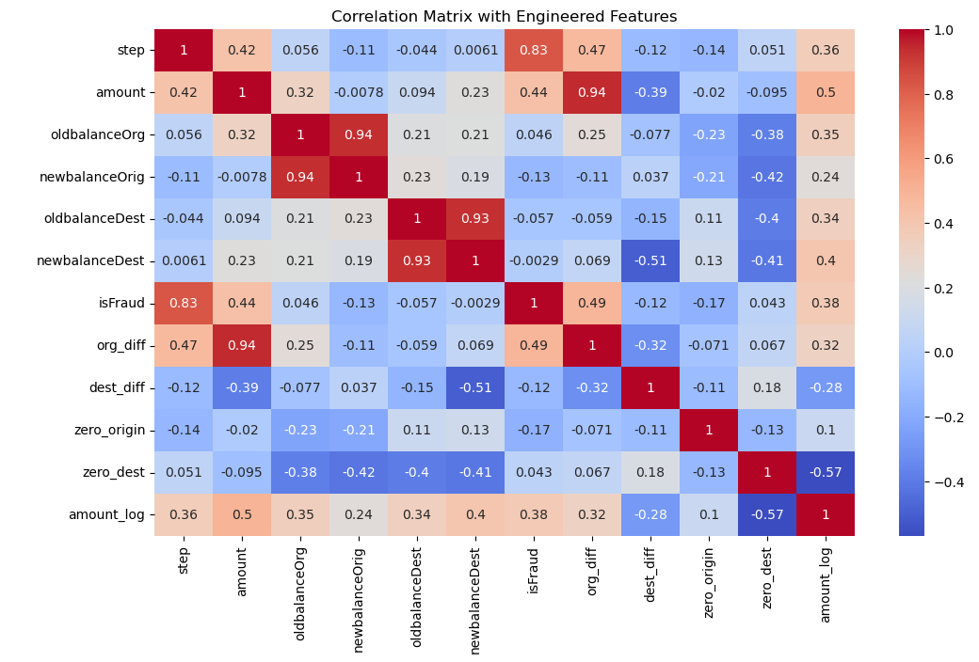
Correlation Analysis of Original and Engineered Features:
This heatmap shows how different transaction features are related to each other and to fraud.
Key engineered features like org_diff, amount_log, and transaction step show strong correlations with the fraud label.
Account balance features follow natural patterns with high internal correlations, while engineered balance-difference features highlight clear fraud signals.
Overall, the heatmap confirms which features have the strongest impact on fraud detection.

Slide 15

Feature Engineering
Feature engineering was performed to create more meaningful variables that highlight fraud-specific patterns in the dataset. These engineered features significantly improved model performance by capturing abnormal transaction behavior.

Slide 16
New Columns
Raw Columns
org_diff
dest_diff
zero_origin
zero_dest
amount_log
is_orig_zero_before
is_dest_zero_before
type_CASH_OUT
type_DEBIT
type_PAYMENT
type_TRANSFER
step
type
amount
nameOrig
oldbalanceOrg
newbalanceOrig
nameDest
oldbalanceDest
newbalanceDest
isFraud
Feature Engineering
Feature Engineering created meaningful new variables such as balance differences, log-transformed amounts, zero-balance indicators, and one-hot encoded transaction types, capturing hidden fraud patterns not visible in raw data. These engineered features significantly improved model accuracy by highlighting abnormal financial behavior strongly associated with fraudulent transactions.

Slide 17
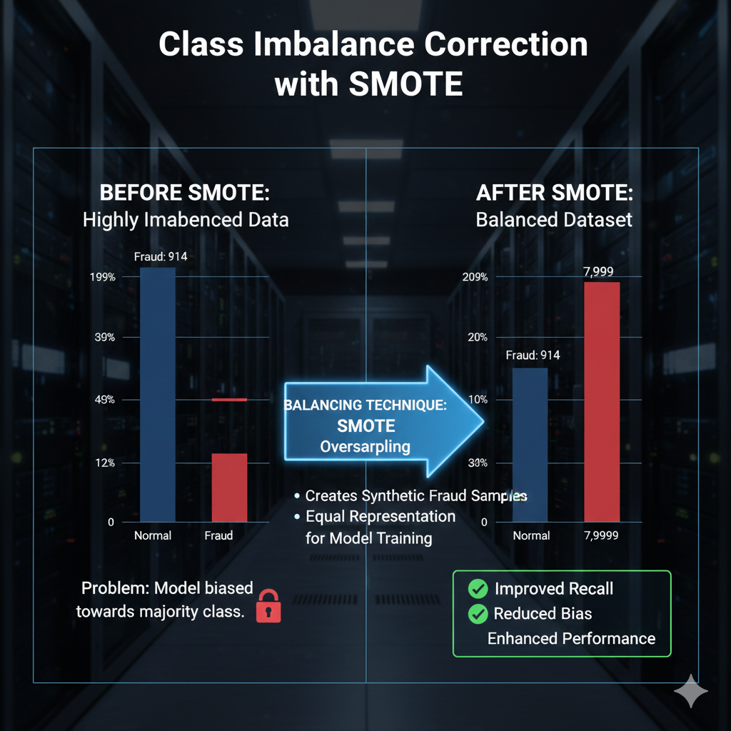
Handling Class Imbalance
Before applying SMOTE, the dataset was highly imbalanced with only 914 fraud cases compared to 7,999 non-fraud cases. After applying SMOTE oversampling, both classes were balanced at 7,999 samples each, giving the model equal representation of fraud and non-fraud patterns. This significantly improves model recall and reduces bias toward the majority class.

Slide 18
Train–Test Split (80% Training, 20% Testing)
80% Training Data → used for model learning
20% Testing Data → used for performance evaluation
Stratified Split → maintains fraud/non-fraud proportion
Ensures fair, unbiased testing of all models
X contains all features, y contains the fraud label
split into 80% train and 20% test using stratified sampling.
Original Dataset
Testing Data 20 (20%)
. Used for Performance Evaluation
. Unseen data
Training Data(80%)
. Used For model learning
. Internal Validation

Slide 19

Model Selection
Three different machine learning models were trained to detect fraudulent transactions: Logistic Regression, Random Forest, and XGBoost. Each model captures fraud behavior differently — from simple linear patterns to complex non-linear relationships. The models were trained on engineered features and balanced data (SMOTE), and their performance was evaluated using precision, recall, F1-score, ROC-AUC, and PR-AUC to identify the best-performing model.

Slide 20
XGBoost
Highest Recall → caught more fraud cases
Highest PR-AUC → strong performance on imbalanced dataset
Best overall predictive accuracy
Strong cluster separation + powerful tree-based modeling
Logistic Regression
Could not capture complex fraud patterns
Used mainly as baseline
Random Forest
Good recall and F1
More stable but slightly less powerful than XGBoost

Slide 21
Model Performance
Models | Precision | Recall | F1-Score | ROC-AUC | PR-AUC
L R | 0.977 | 0.951 | 0.964 | 0.992 | 0.987
R F | 0.995 | 0.986 | 0.991 | 0.999 | 0.999
XGBOOST | 0.991 | 0.995 | 0.993 | 0.999 | 0.999

Slide 22
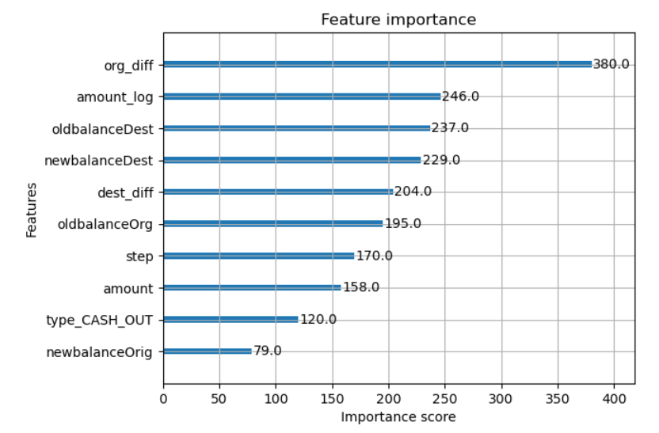
Feature Importance
Top 10 Features
Feature importance analysis revealed that engineered features such as org_diff, amount_log, and balance-related variables contribute the most to fraud prediction. Origin balance difference (org_diff) emerged as the strongest predictor, followed by transaction amount (log-transformed), destination balance values, and transaction type indicators like CASH_OUT. These high-impact features help the model identify unusual money movements strongly associated with fraudulent behavior.

Slide 23
Conclusion
The fraud detection system achieved highly accurate and reliable results after applying feature engineering, SMOTE balancing, and advanced machine learning models. XGBoost delivered the strongest overall performance with a Precision of 99.13%, Recall of 99.56%, F1-Score of 99.34%, ROC-AUC of 99.99%, and PR-AUC of 99.95%.
Random Forest also performed well, achieving an F1-Score of 99.11%, while Logistic Regression served as a solid baseline with a 96.44% F1-Score. The dominance of engineered features—such as org_diff, amount_log, and balance differences—played a critical role in boosting model accuracy and enabling effective fraud detection.
Future Scope
The system can evolve into a fully automated, real-time fraud detection engine with adaptive learning and advanced graph-based analytics.

Slide 24
Thank You!

